Slide 1
Intro Workshop with CS4CS
With John Cunniff & Andre Hu

Slide 2
whoami
John Cunniff
Senior at NYU
Computer Science
Cisco Systems, Vola Dynamics, Anubis LMS & Planetcurious
Former President & Current Infra Manager for the OSIRIS Lab

Slide 3
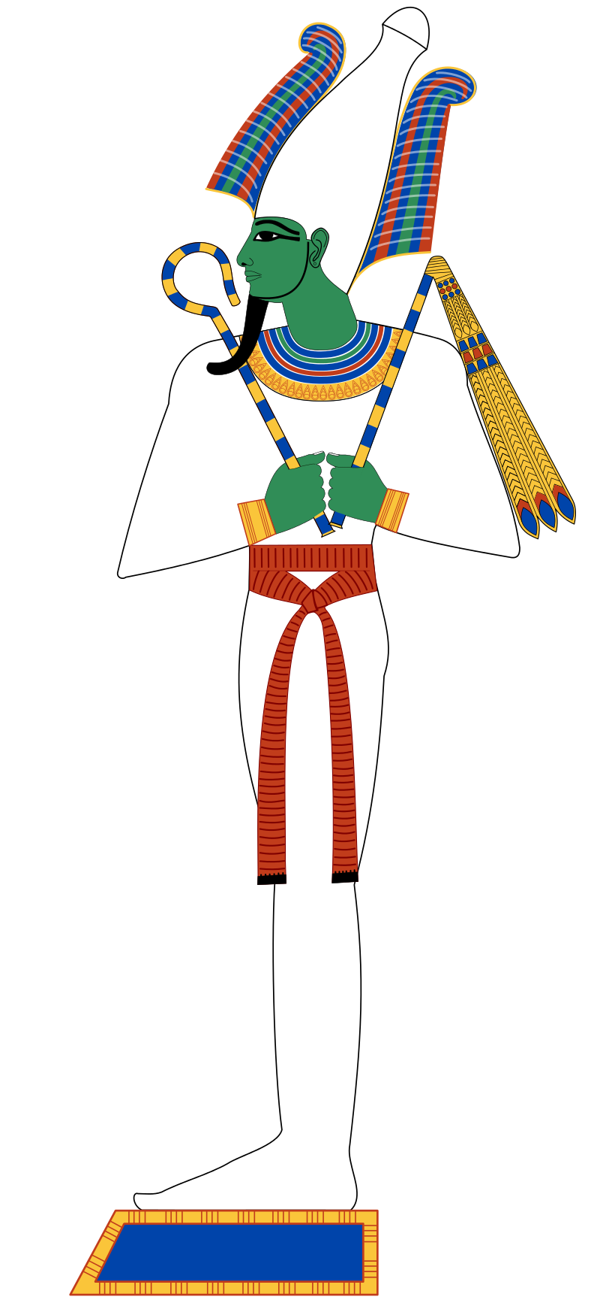
What is OSIRIS
The Egyptian Lord of the Underworld
Judge of the Dead
Brother-husband to Isis

Slide 4
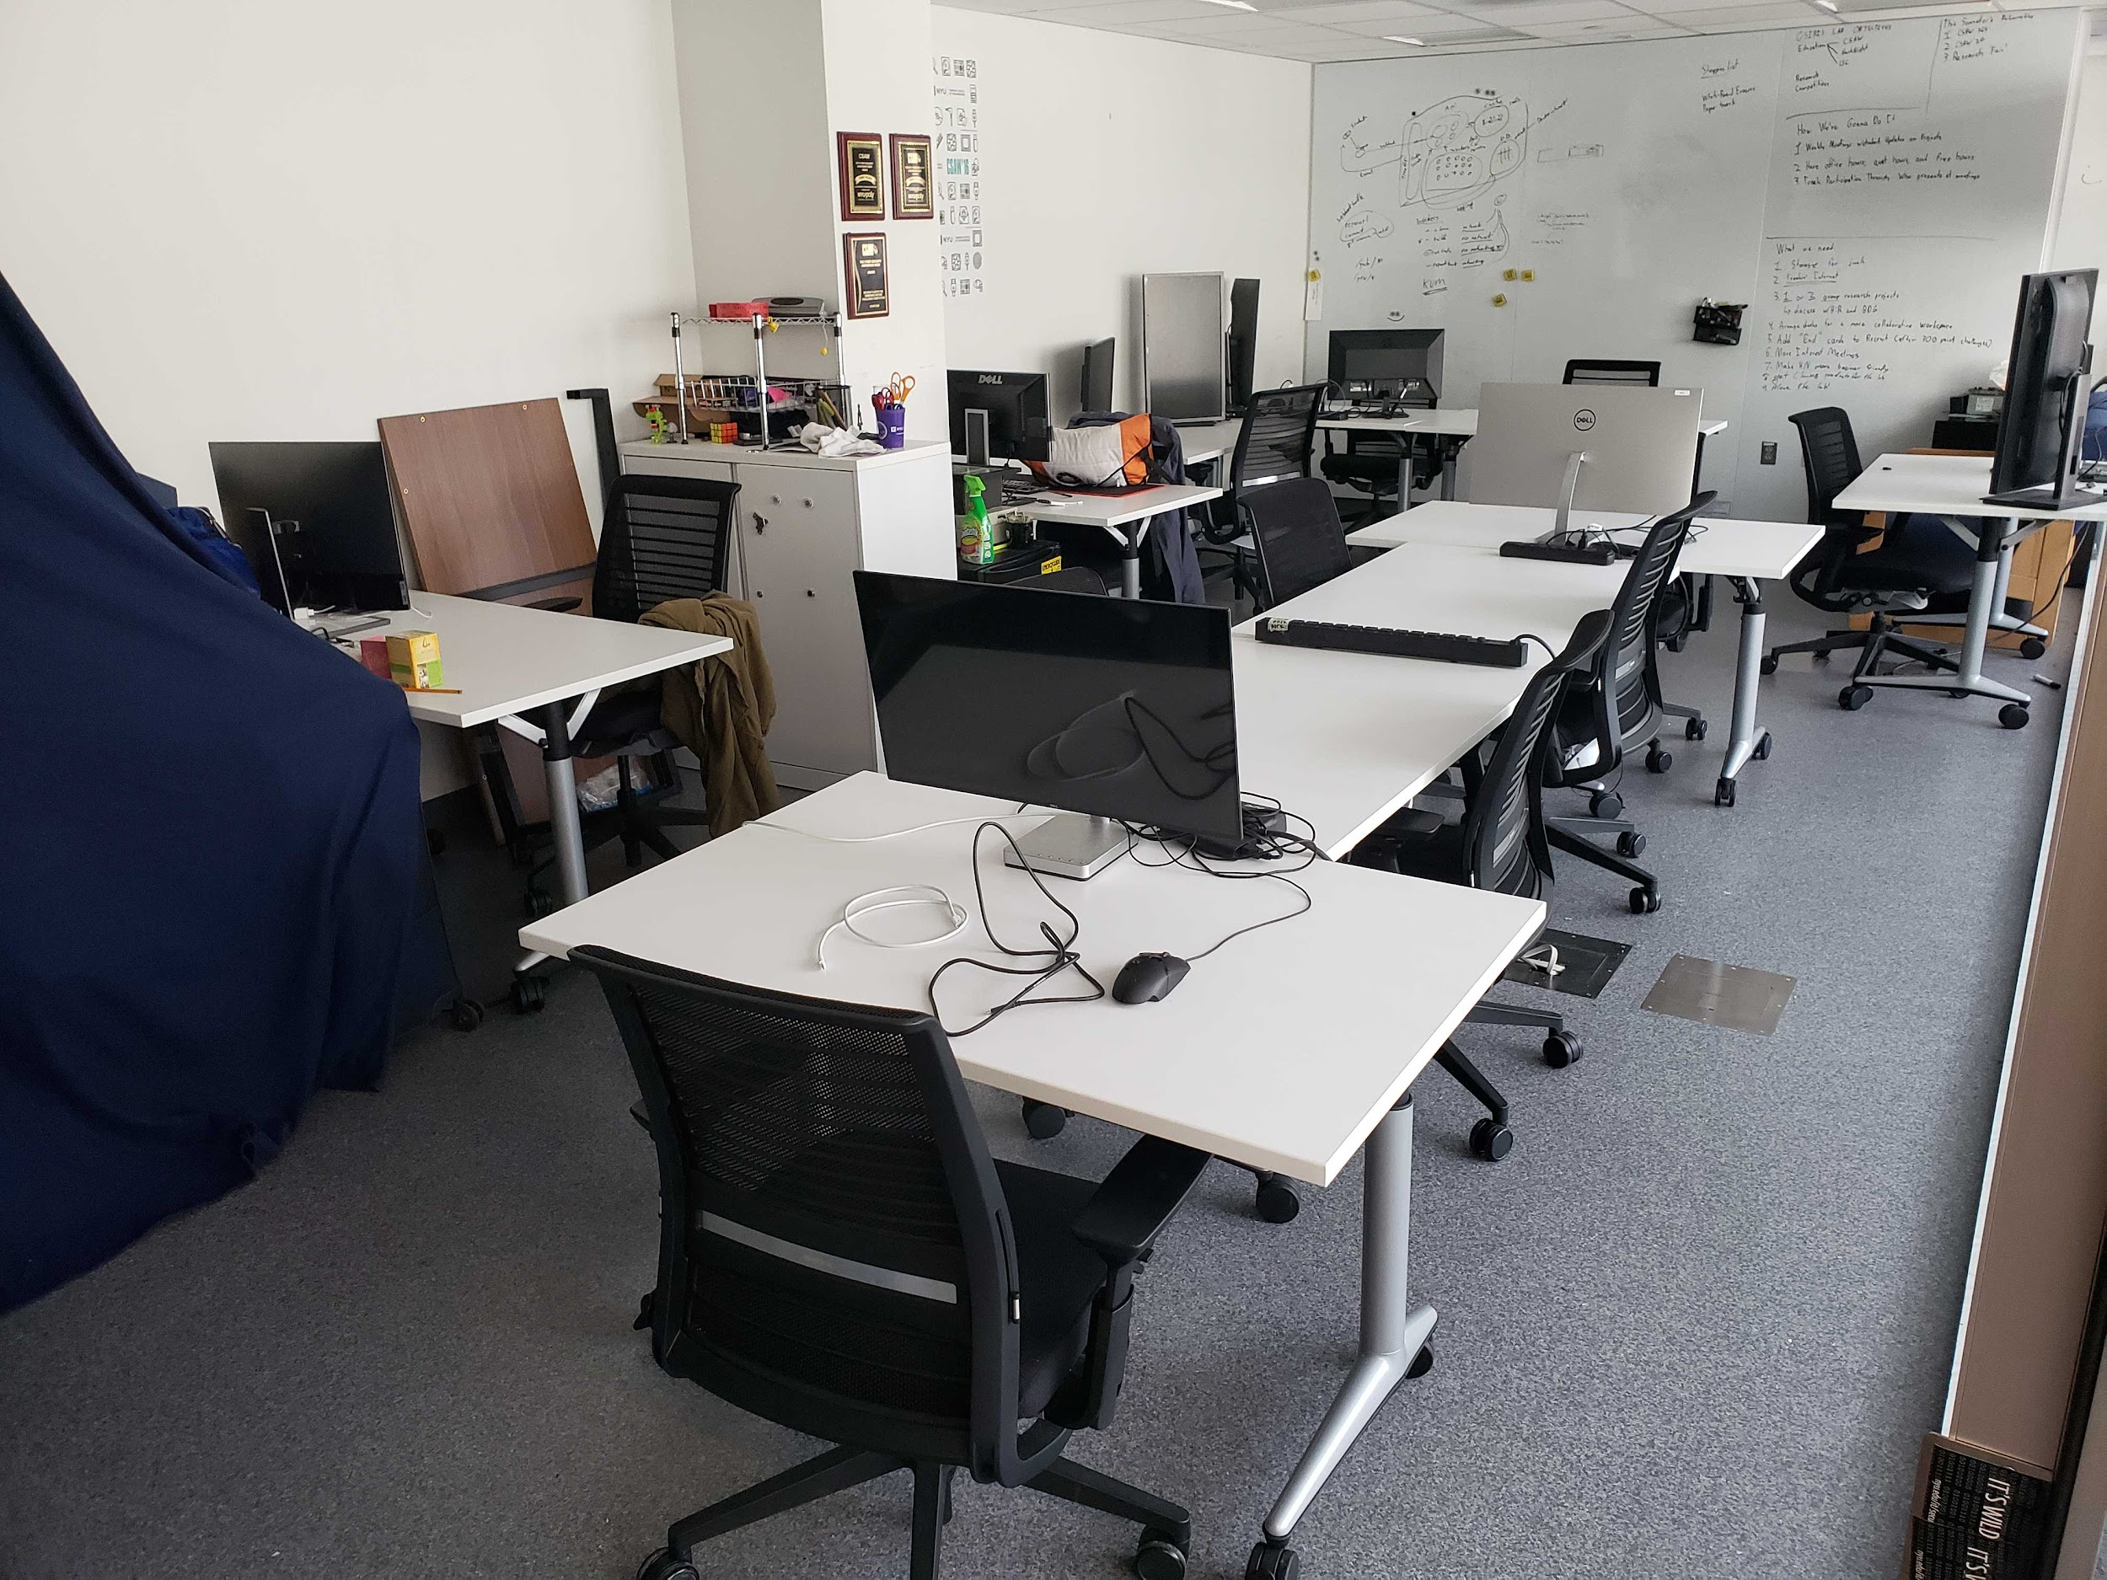
What is OSIRIS
The Offensive Security, Incident Response, and Internet Security Lab
(A bad backronym)
Room 1066, 370 Jay Street
A couple of desks
A couple of chairs
A handful of servers

Slide 5
What does the OSIRIS Lab do
Education
HackNight
Cyber Security Club
CSAW
Events like these
Competition
Capture the Flag as NYUSEC
Research
Embedded Device Hacking, Compiler Fuzzing, Binary Obfuscation..to name a few

Slide 6
What is the Internet?

Slide 7
What is the Internet?
Hamsters running messages through a labyrinth of tubes
Three New York City rats in a trenchcoat
Cat videos
A sleep-deprived college kid trying to configure a broken web-server at 1am for the third time this week that just won’t work

Slide 8
What is the Internet?
Hamsters running messages through a labyrinth of tubes
Three New York City rats in a trenchcoat
Cat videos
A sleep-deprived college kid trying to configure a broken web-server at 1am for the third time this week that just won’t work

Slide 9
But Actually...
It’s a bunch of computers connected by wires owned by people that are using other people’s software to send data to other people’s computers

Slide 10
But Actually...
It’s a bunch of computers connected by wires owned by people that are using other people’s software to send data to other people’s computers
(And nobody understands how to configure that software and everything is bad)

Slide 11
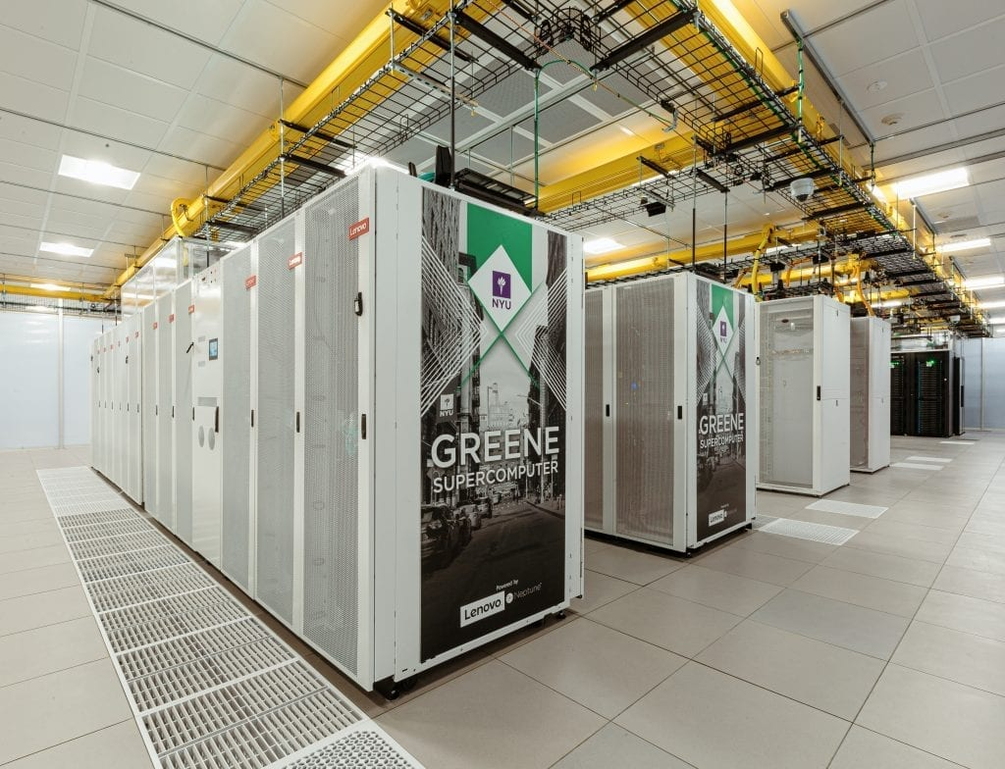

This is what the Internet looks like
This is what the Internet looks like

Slide 12
This is what the Internet looks like
They are loud and cold places with no windows :(

Slide 13
This is what the Internet looks like
They are loud and cold places with no windows :(
Yeah this is a supercomputer, but they look the same

Slide 14
For example….
http://www.townsportsinternational.com - find the login
https://google.com - find something Google doesn’t want you to know!

Slide 15
And now something for you to do
cs4cs.osiris.cyber.nyu.edu

Slide 16
Now Hack the Planet!
https://recruit.osiris.cyber.nyu.edu (not right now)
https://xss-game.appspot.com
https://microcorruption.com
https://ctf.csaw.io (in a couple more months)
https://picoctf.com
https://sourcery.pwnadventure.com
And so many more….

